Slide 1
Statistical Inference
Dr. Bhakti Palkar
1

Slide 2
Layout
Principle of Statistical Inference (SI)
Hypothesis in SI
Hypotheses testing procedures
Errors in hypothesis testing
Case Study 1: Coffee Sale
Case Study 2: Machine Testing
Summary of Sampling Distributions in Hypothesis Testing
2

Slide 3
Statistical Inference
The process of making guesses about the truth from a sample.
Sample statistics
Truth (not observable)
Sample (observation)
*hat notation ^ is often used to indicate “estitmate”
Population parameters
Make guesses about the whole population

Slide 4
Statistics vs. Parameters
Sample Statistic – any summary measure calculated from data; e.g., could be a mean, a difference in means or proportions, an odds ratio, or a correlation coefficient
E.g., the mean vitamin D level in a sample of 100 men is 63 nmol/L
E.g., the correlation coefficient between vitamin D and cognitive function in the sample of 100 men is 0.15
Population parameter – the true value/true effect in the entire population of interest
E.g., the true mean vitamin D in all middle-aged and older men is 62 nmol/L
E.g., the true correlation between vitamin D and cognitive function in all middle-aged and older men is 0.15

Slide 5
Statistical Inference -Approaches
Approach 1: Hypothesis testing
We hypothesize that one or more parameter(s) has (have) some specific value(s) or relationship.
Make our decision about the parameter(s) based on one (or more) sample statistic(s)
Accuracy of the decision is expressed as the probability that the decision is incorrect.
Approach 2: Confidence interval measurement
We estimate one (or more) parameter(s) using sample statistics.
This estimation usually done in the form of an interval.
Accuracy of the decision is expressed as the level of confidence we have in the interval.
5

Slide 6
What is Hypothesis?
“A hypothesis is an educated prediction that can be tested” (study.com).
“A hypothesis is a proposed explanation for a phenomenon” (Wikipedia).
“A hypothesis is used to define the relationship between two variables” (Oxford dictionary).
Example: “The volume of a gas is directly proportional to the number of molecules of the gas.”
6

Slide 7
Statistical Hypothesis
If the hypothesis is stated in terms of population parameters (such as mean and variance), the hypothesis is called statistical hypothesis.
Data from a sample (which may be an experiment) are used to test the validity of the hypothesis.
A procedure that enables us to agree (or disagree) with the statistical hypothesis is called a test of the hypothesis.
Example:
To determine whether the wages of men and women are equal.
A product in the market is of standard quality.
Whether a particular medicine is effective to cure a disease.
7

Slide 8
The Hypotheses
The main purpose of statistical hypothesis testing is to choose between two competing hypotheses.
Hypothesis testing start by making a set of two statements about the parameter(s) in question.
.
8

Slide 9
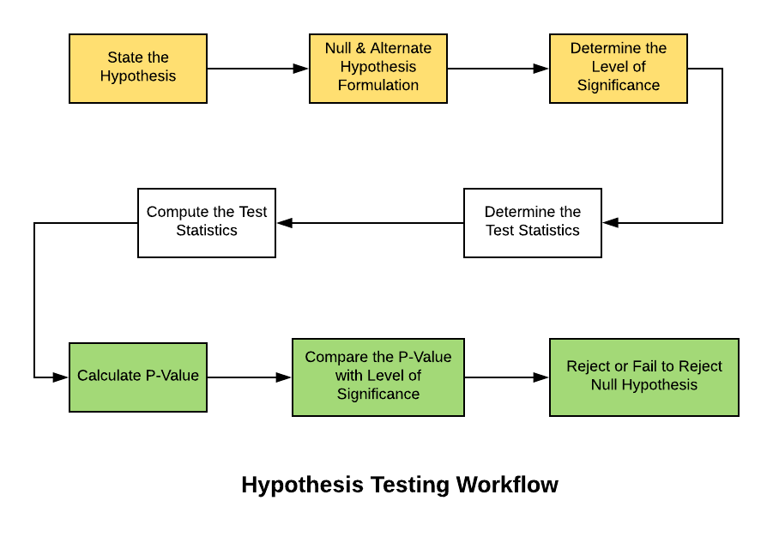
Hypothesis Testing
10

Slide 10
1. Null & Alternative hypothesis
The null and alternative hypotheses are the two mutually exclusive statements about a parameter or population mentioned in the introduction.
Null hypothesis : The hypothesis actually to be tested is usually given the symbol 𝐻0 and is commonly referred as the null hypothesis.
Alternate hypothesis :The other hypothesis, which is assumed to be true when null hypothesis is false, is referred as the alternate hypothesis and is often symbolized by 𝐻1
Example : One hypothesis might claim that wages of men and women are equal, while the alternative might claim that men make more than women.

Slide 11
Case I : H0 : μ=μ0 , HA: μ ≠μ0
e.g. we want to test that the population mean is different than 50
Case II : H0 : μ = μ0 , HA: μ > μ0
e.g. we want to test that the population mean is greater than 50
Case III : H0: μ = μ0 , HA: μ< μ0
e.g. we want to test that the population mean is less than 50
The null hypothesis should contain an equality (=, ≤ ,≥):
old scores ≥ new scores
The alternate hypothesis should not have an equality (≠,<,>):
old scores < new scores

Slide 12
2. Selection of an appropriate test statistic
To test your claims, you need to decide on the right test or test statistic. There are two types of tests of hypotheses
1. Non parametric tests (also called distribution free test of hypotheses)
2. Parametric tests (also called standard test of hypotheses)
It is a random variable as it is derived from a random sample. In hypothesis tests, it compares the sample statistic to the expected result of the null hypothesis. The selection of the test statistic is dependent on:
Parametric vs. non-parametric
Number of samples (one, two, multiple)
Discrete (e.g. number of customers) or continuous variable (e.g. order value)

Slide 13
 Testing hypothesis for the mean μ :
 When the value of sample size (n):
population is normal or not normal
population is normal (n< 30)

( n ≥ 30 )
σ is known
σ is not known
σ is known
σ is not
known
X − μ
X − μ
X − μ
X − μ
Z =
0
S
n
Z =
0
_{T =} 0
Z =
σ
0
σ
S
n
n
n

Slide 14
2. Selection of an appropriate test statistic
Let’s assume that the mean average order value AOV in your web shop used to be $20. After hiring a new web designer with promising skills, the AOV increased to $22. You want to test whether the mean AOV has significantly increased:
Parameter: mean AOV (continuous variable, assumed to be normally distributed)
Sample statistic: $22 (one sample)
Expected value: $20
Test statistic: t-score
Test: one-sample t-test

Slide 15
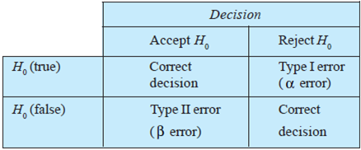
3. Selection of the appropriate significance level
We can make four different decisions with Hypothesis Testing:
1. Reject H0(Accepting the alternate Hypothesis H1) and H0 is not true (no error).
2. Do not reject H0 and H0 is true (no error).
3. Reject H0 and H0 is true (Type 1 Error).
4. Do not reject H0 and H0 is not true (Type 2 error).

Slide 16
3. Selection of the appropriate significance level
Type I error: Rejecting the null hypothesis when it is true.
Type II error: Accepting the null hypothesis when it is false.
Alpha is the probability of the type I error and the chance of making a mistake by rejecting the null hypothesis when it is true. The lower the alpha, the better. It is, therefore, used as a threshold to make decisions. Before starting a hypothesis test, you generally pick an error level you are willing to accept. For example, you are willing to accept a 5% chance that you’re mistaken when you reject the null hypothesis.

Slide 17
3. Selection of the appropriate significance level (alpha)
Power of a test
Beta is the probability of the type II error.
1-beta is the probability of not making a Type II error and defined as the power of a test.
The lower the beta, the higher the power.
We would like to keep both errors as low as possible.
Both errors somewhat work against each other: Assume you want to minimise error I or the mistake of rejecting the null hypothesis when it is true. Then, the easiest way would be to just always accept it. But this would then work directly against the type II error, namely accepting it when it is not true.
Commonly used significance (alpha) levels 0.01, 0.05, or 0.10 serve as a good balance and should be determined before data collection.

Slide 18
Two-Tailed Test
Acceptance region Accept H₀ ,if the sample mean falls in this region
95 % of area
0.025 of area
0.025 of area
µH⁰
Rejection region
Reject H₀ ,if the sample mean falls in either of these regions
Acceptance and rejection regions in case of a two-tailed test with 5% significance(alpha) level. in a two-tailed test, the alpha level is split in half and applied to both sides of the sampling distribution of a statistic.
When the p value is less than 5% (p < .05), we reject the null hypothesis

Slide 19
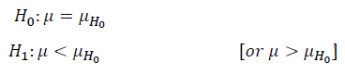
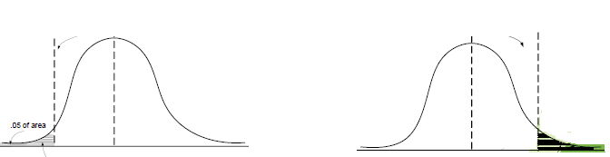
One-Tailed Test
A one-tailed test would be used when we are to test, say, whether the population mean is either lower or higher than the hypothesis test value.
Wherein there is one rejection region only on the left-tail (or right-tail).
0.05 % of area
Rejection region
Rejection region
Left − tailed test
Right − tailed test

Slide 20
4. Data collection
To run a hypothesis test, we need a portion of the true population of interest, a random sample.
The sample should be randomly selected to avoid any bias or undesirable effects.

Slide 21
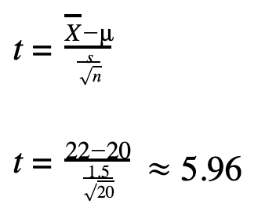
5. Calculation of the test statistics and the p-value
Once the data is collected, the chosen test statistic and the corresponding p-value can be calculated.
Both values can be used to make your final decision on inference and are retrieved from the probability distribution from the test statistic (also sampling distribution).
How to calculate the test statistic?
Ans: formula (can be found online)/ SPSS statistical software/R/python. Ex. Assuming a sample size (n) of 20, sample mean 22, population mean 20 and a sample standard deviation (s) of 1.5, our test statistic is:

Slide 22
5. Calculation of the test statistics and the p-value
The p-value
The p-value tells you, given the evidence that you have (data), if the null hypothesis looks ridiculous or not […] The lower the p-value, the more ridiculous the null hypothesis looks.
The p-value is a value between 0% and 100% and can be retrieved from the null hypothesis, sampling distribution, and the data.
Generally, it is calculated with the help of statistical software or reading off a distribution table with set parameters (degrees of freedom, alpha level etc.).
Distribution tables with the most common parameters can be found online for most test statistics, like t-score, chi-squared score, or Wilcoxon-rank-sum.

Slide 23
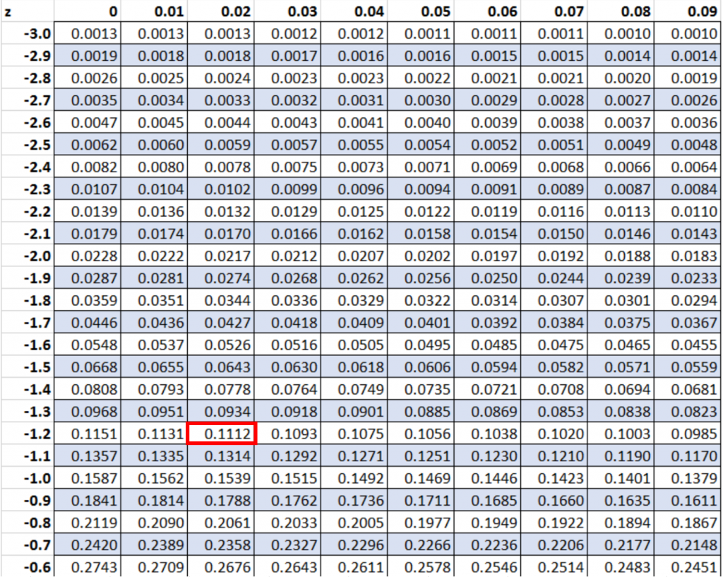
How to Calculate a P-Value from a Z-Score by Hand
Example 1: Find P-Value for a Left-Tailed Test
Suppose we conduct a left-tailed hypothesis test and get a z-score of -1.22. What is the p-value that corresponds to this z-score?
To find the p-value, we can simply locate the value -1.22 in the z table:
The p-value that corresponds to a z-score of -1.22 is 0.1112.

Slide 24
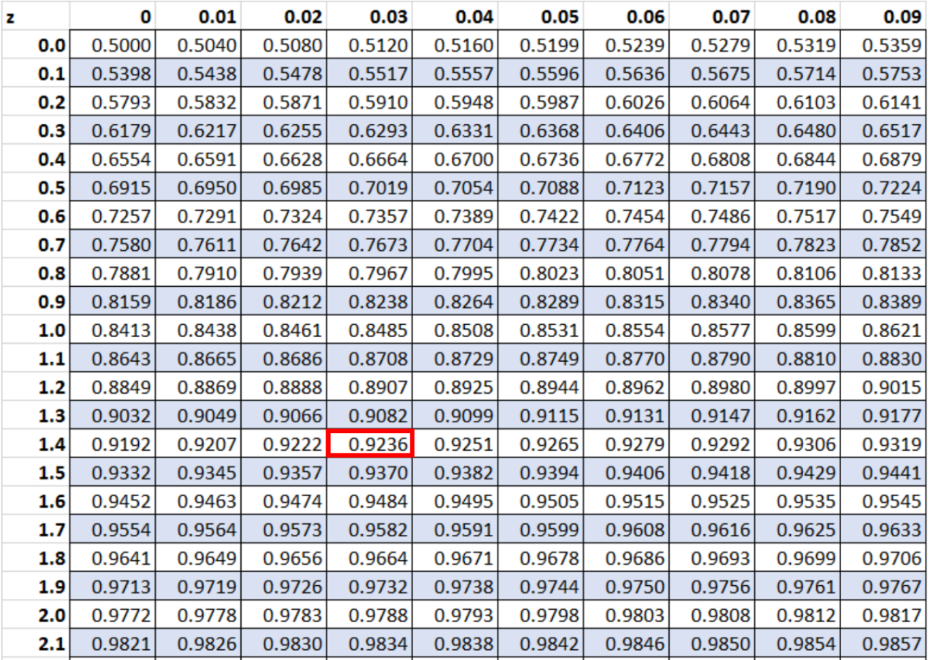
How to Calculate a P-Value from a Z-Score by Hand
Example 2: Find P-Value for a Right-Tailed Test
Suppose we conduct a right-tailed hypothesis test and get a z-score of 1.43. What is the p-value that corresponds to this z-score?
To find the p-value, we can first locate the value 1.43 in the z table:
Since we’re conducting a right-tailed test, we can then subtract this value from 1.
So our final p-value is: 1 – 0.9236 = 0.0764.

Slide 25
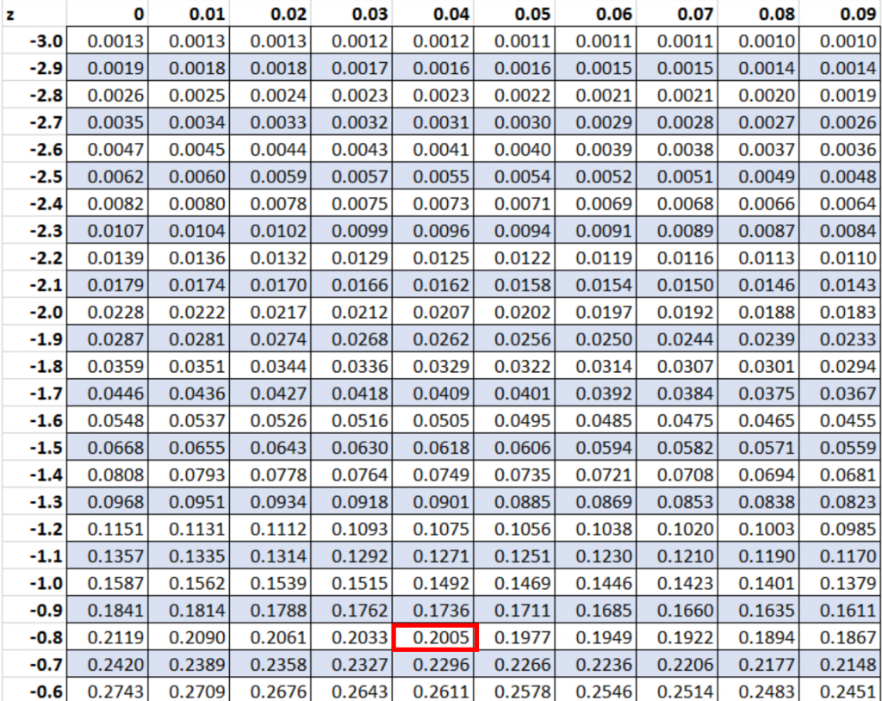
How to Calculate a P-Value from a Z-Score by Hand
Example 3: Find P-Value for a Two-Tailed Test
Suppose we conduct a two-tailed hypothesis test and get a z-score of -0.84. What is the p-value that corresponds to this z-score?
To find the p-value, we can first locate the value -0.84 in the z table:
Since we’re conducting a two-tailed test, we can then multiply this value by 2.
So our final p-value is: 0.2005 * 2 = 0.401.

Slide 26
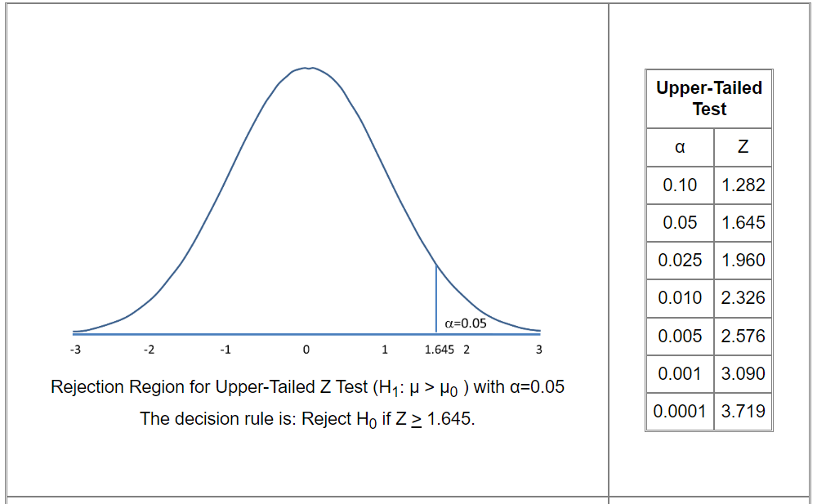
Critical value for Z test

Slide 27
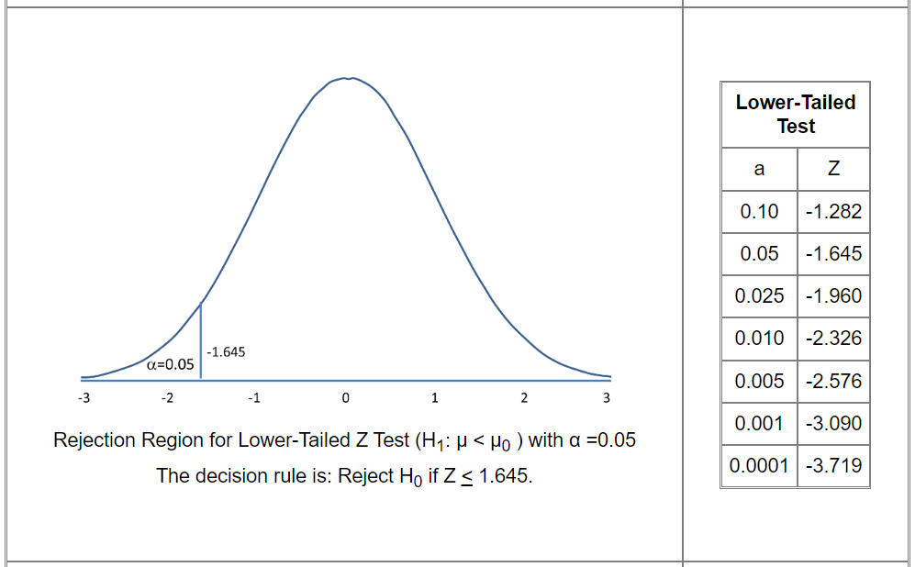
Critical value for Z test

Slide 28
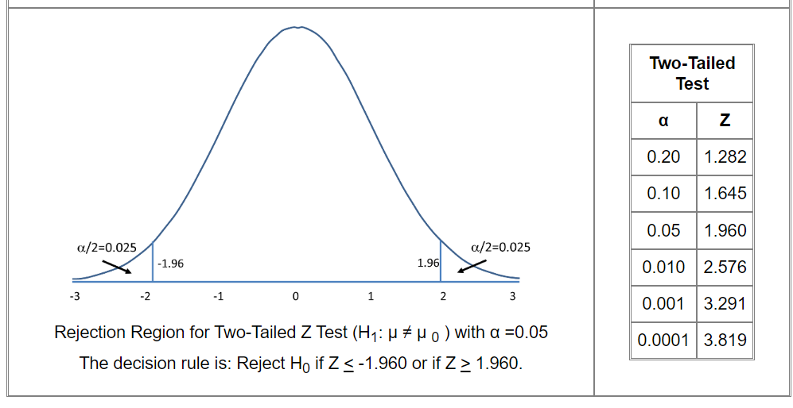
Critical value for Z test

Slide 29
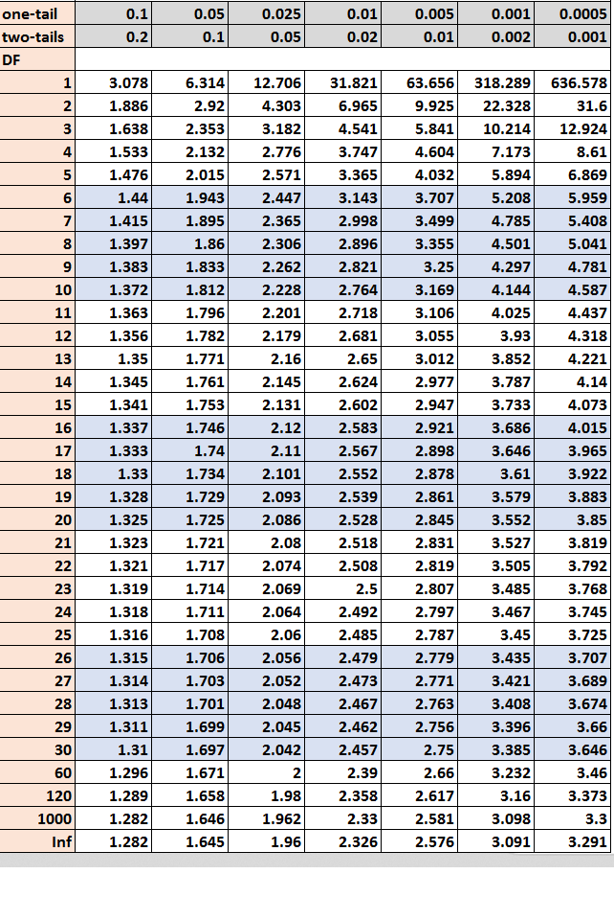
How to Find the P-Value from the t-Distribution Table
The t distribution table is a table that shows the critical values of the t distribution. To use the t distribution table, you only need three values:
A significance level (common choices are 0.01, 0.05, and 0.10)
The degrees of freedom
The type of test (one-tailed or two-tailed)

Slide 30
The t distribution table is commonly used in the following hypothesis tests:
A hypothesis test for a mean
A hypothesis test for a difference in means
A hypothesis test for a difference in paired means
When you conduct each of these tests, you’ll end up with a test statistic t. To find out if this test statistic is statistically significant at some alpha level, you have two options:
1. Compare the test statistic t to a critical value from the t distribution table.
2. Compare the p-value of the test statistic t to a chosen alpha level.

Slide 31
6.DECESION
Test statistic approach
P Value approach
Test statistic is compared to a critical value
If the test statistic is greater than the critical value, then the null hypothesis is rejected in favour of the alternative hypothesis with a confidence level of 1-alpha.
If the test statistic is smaller than the critical value, the null hypothesis is not rejected.
P-value is compared to the alpha-level
if the p <= alpha, the null hypothesis is rejected in favour of the alternative hypothesis with confidence level 1-alpha.
If the p-value is greater than the alpha-level, the null hypothesis is accepted.

Slide 32
Example : Calculating 𝛼and 𝜷
There are two identically appearing boxes of chocolates Box A contains 60 red and 40 black chocolates whereas box B contains 40 red and 60 black chocolates There is no label on the either box One box is placed on the table We are to test the hypothesis that “Box B is on the table”
To test the hypothesis an experiment is planned, which is as follows
Draw at random five chocolates from the box
We replace each chocolates before selecting a new one
The number of red chocolates in an experiment is considered as the sample Statistics
Since each draw is independent to each other, we can assume the sample distribution Follows binomial probability distribution

Slide 33
EXAMPLE : CALCULATING 𝛼AND 𝜷
Let us express the population parameter as
𝑝=the number of red chocolates in Box 𝐵.
The hypotheses of the problem can be stated as
𝐻0:𝑝=0.4 // Box B is on the table
𝐻1:𝑝=0.6 // Box A is on the table
Calculating 𝜶:
In this example, the null hypothesis(𝐻0)specifies that the probability of drawing a red chocolate is 0.4 This means that, lower proportion of red chocolates in observations (𝑖.𝑒.,𝑠𝑎𝑚𝑝𝑙𝑒) favors the null hypothesis In other words, drawing all red chocolates provides sufficient evidence to reject the null hypothesis.

Slide 34
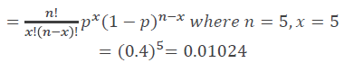
Then, the probability of making a 𝑇𝑦𝑝𝑒𝐼error is the probability of getting five red chocolates in a sample of five from Box B. That is
Using the binomial distribution
Thus, the probability of rejecting a true null hypothesis isis≈0.01.That is, there is approximately1in100 chance that the box B will be mislabeled as box A

Slide 35
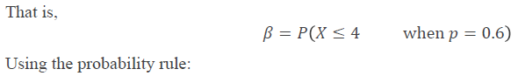
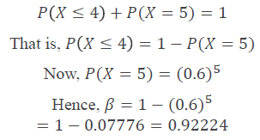
Calculating 𝜷:
The 𝑇𝑦𝑝𝑒𝐼𝐼error occurs if we fail to reject the null hypothesis when it is not true. For the current illustration, such a situation occurs, if Box A is on the table but we did not get the five red chocolates required to reject the hypothesis that Box B is on the table
The probability of 𝑇𝑦𝑝𝑒𝐼𝐼error is then the probability of getting four or fewer red chocolates in a sample of five from Box A
That is, the probability of making 𝑇𝑦𝑝𝑒𝐼𝐼error is over This means that, if Box A is on the table but we did not get the five red chocolates required to reject the hypothesis that Box B is on the table.

Slide 36

Case Study 1: Coffee Sale
A coffee vendor nearby a railway station has been having average sales of 500 cups per day. Because of the development of a bus stand nearby, it expects to increase its sales. During the first 12 days, after the inauguration of the bus stand, the daily sales were as under:
550 570 490 615 505 580 570 460 600 580 530 526
On the basis of this sample information, can we conclude that the sales of coffee
have increased?
Consider 5% level of confidence.

Slide 37
Hypothesis Testing : 5 Steps
The following five steps are followed when testing hypothesis
1. Specify 𝐻0and 𝐻1, the null and alternate hypothesis, and an acceptable level of 𝜶
2. Determine an appropriate sample based test statistics and the rejection region
for the specified 𝐻0
3. Collect the sample data and calculate the test statistics.
4. Make a decision to either reject or fail to reject 𝐻0
5. Interpret the result in common language suitable for practitioner.

Slide 38
Case Study 1: Step 1
Step1: Specification of hypothesis and acceptable level of 𝛂
Let us consider the hypotheses for the given problem as follows
𝐻0:𝜇=500cups per day
The null hypothesis that sales average 500 cups per day and they have not increased
𝐻a:𝜇>500
The alternative hypothesis is that the sales have increased
Given the acceptance level of 𝛼=0.05(𝑖.𝑒.,5%𝑙𝑒𝑣𝑒𝑙𝑜𝑓𝑠𝑖𝑔𝑛𝑖𝑓𝑖𝑐𝑎𝑛𝑐𝑒)

Slide 39
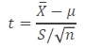
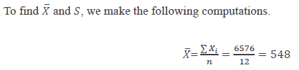
Case Study 1: Step 2
Step 2: Sample based test statistics and the rejection region for specified 𝐇𝟎
Given the sample as
550 570 490 615 505 580 570 460 580 530 526
Since the sample size is small and the population standard deviation is not known, we shall use 𝑡−𝑡𝑒𝑠𝑡assuming normal population The test statistics 𝑡 is

Slide 40
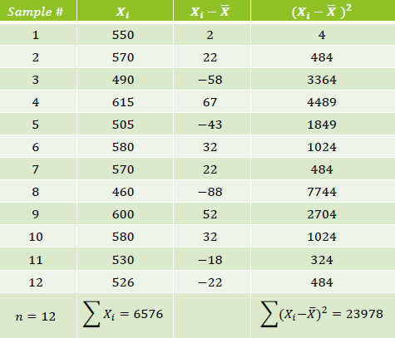
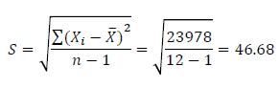
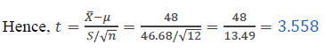
Case Study 1: Step 2
Step 3: Collect the sample data and calculate the test statistics
𝐷𝑒𝑔𝑟𝑒𝑒𝑜𝑓𝑓𝑟𝑒𝑒𝑑𝑜𝑚=𝑛−1=12−1=11

Slide 41
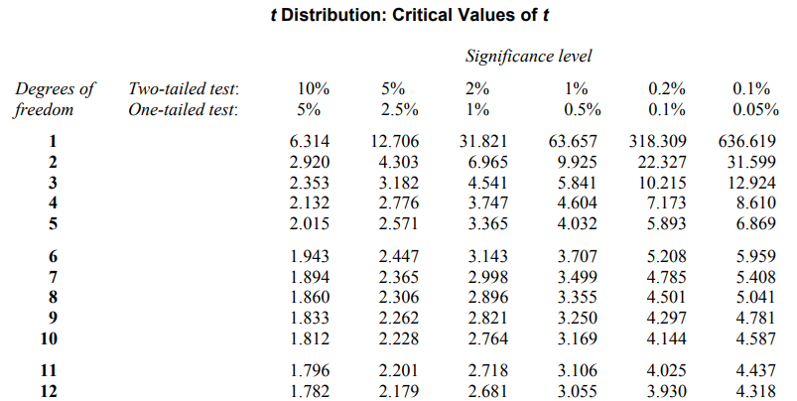
Case Study 1: Step 3,4,5
As 𝐻1is one tailed, we shall determine the rejection region applying one tailed in the right tail because 𝐻1is more than type at 5%level of significance
Using table of 𝑡−𝑑𝑖𝑠𝑡𝑟𝑖𝑏𝑢𝑡𝑖𝑜𝑛 for 11 degrees of freedom and with 5% level of significance,
Critical Value=1.796
Step 4: The observed value of t(3.558)> 1.796 which is in the rejection region and thus 𝐻0 is rejected at5%level of significance
Step 5: Final comment and interpret the result.
We can conclude that the sample data indicate that coffee sales have increased

Slide 42

Case Study 2: Machine Testing
Medicine production company packages medicine in a tube of 8 ml. In maintaining the control of the amount of medicine in tubes, they use a machine.
To monitor this control a sample of 16 tubes is taken from the production line at random time interval and their contents are measured precisely. The mean amount of medicine in these 16 tubes will be used to test the hypothesis that the machine is indeed working properly.

Slide 43
Case Study 2: Step 1
Step 1: Specification of hypothesis and acceptable level of 𝛂
The hypotheses are given in terms of the population mean of medicine per tube.
The null hypothesis is
𝐻0:𝜇=8
The alternative hypothesis is
𝐻1:𝜇≠8
We assume 𝛼, the significance level in our hypothesis testing ≈0.05.
(This signifies the probability that the machine needs to be adjusted less than 5%)

Slide 44
CASE STUDY 2: STEP 2
Step 2: Sample based test statistics and the rejection region for specified 𝐇𝟎
Rejection region:
Given 𝛼=0.05, which gives 𝑍>1.96
(obtained from standard normal calculation for 𝑛(𝑍:0,1)=0.025
For a rejection region with two tailed test).

Slide 45
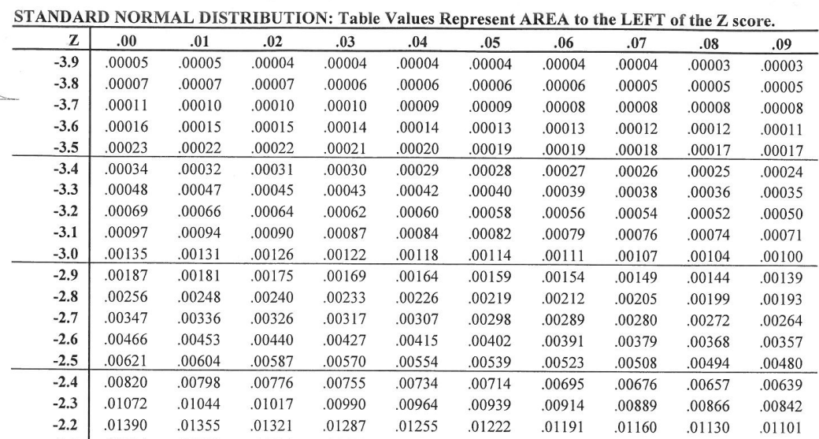
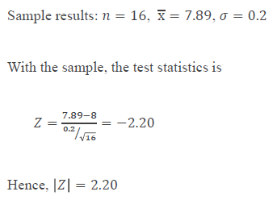
CASE STUDY 2: STEP 3
Step 3: Collect the sample data and calculate the test statistics
P Value=0.01390*2=0.0278

Slide 46
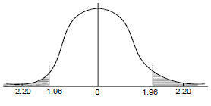
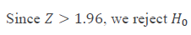
CASE STUDY 2: STEP 4,5
Step 4: Make a decision to either reject or fail to reject H0
Step 5: 5 Final comment and interpret the result
We conclude 𝜇≠8 and recommend that the machine be adjusted.
Z=2.20
P Value=0.01390*2=0.0278
Since 0.0278< 0.05 (Significance level)
Reject H₀

Slide 47
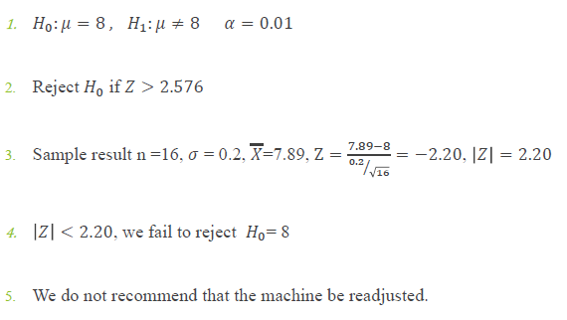
Case Study 2: Alternative Test
Suppose that in our initial setup of hypothesis test, if we choose
𝛼=0.01instead of 0.05, then the test can be summarized as:

Slide 48
Hypothesis Testing Strategies
The hypothesis testing determines the validity of an assumption (technically described as null hypothesis), with a view to choose between two conflicting hypothesis about the value of a population parameter
There are two types of tests of hypotheses
1. Non parametric tests (also called distribution free test of hypotheses)
2. Parametric tests (also called standard test of hypotheses)

Slide 49
Parametric Tests : Applications
Usually assume certain properties of the population from which we draw samples
• Observation come from a normal population
• Sample size is small
• Population parameters like mean, variance, etc are hold good
• Requires measurement equivalent to interval scaled data

Slide 50
Parametric Tests
The widely used sampling distribution for parametric tests are
1. 𝑍−𝑡𝑒𝑠𝑡
2. 𝑡−𝑡𝑒𝑠𝑡
3. 𝜒2−𝑡𝑒𝑠𝑡
4. 𝐹−𝑡𝑒𝑠𝑡
Note: All these tests are based on the assumption of normality (i e the source of data is considered to be normally distributed)

Slide 51
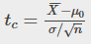
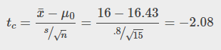
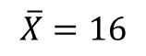
Problem: Jeffrey, as an eight-year old, established a mean time of 16.43 seconds for swimming the 25-yard freestyle, with a standard deviation of 0.8 seconds. His dad, Frank, thought that Jeffrey could swim the 25-yard freestyle faster using goggles. Frank bought Jeffrey a new pair of expensive goggles and timed Jeffrey for 15 25-yard freestyle swims. For the 15 swims, Jeffrey's mean time was 16 seconds. Frank thought that the goggles helped Jeffrey to swim faster than the 16.43 seconds. Conduct a hypothesis test using a preset α = 0.05.
Solution 1
Since the problem is about a mean, this is a test of a single population mean.
Set the null and alternative hypothesis:
In this case there is an implied challenge or claim. This is that the goggles will reduce the swimming time. The effect of this is to set the hypothesis as a one-tailed test. The claim will always be in the alternative hypothesis because the burden of proof always lies with the alternative. The null and alternative hypotheses are thus:
H₀: μ ≥ 16.43 H_{a}: μ < 16.43
For Jeffrey to swim faster, his time will be less than 16.43 seconds. The "<" tells you this is left-tailed.
Determine the distribution needed:
The sample size is less than 30 so this is a t-test.
μ₀ = 16.43
s = 0.8, and n = 15.
$$\overline{X}=16$$

Slide 52
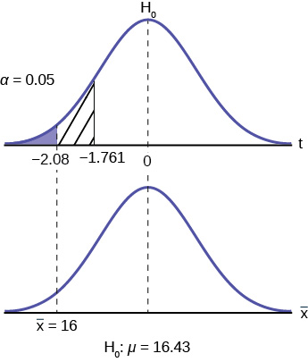
For this problem the degrees of freedom are n-1, or 14. Looking up 14 degrees of freedom at the 0.05 column of the t-table we find 1.761. This is the critical value and we can put this on our graph.
The test statistic is in the tail.
The probability that an average time of 16 minutes could come from a distribution with a population mean of 16.43 minutes is too unlikely for us to accept the null hypothesis. We cannot accept the null.
“With 95% significance we believe that the goggles improves swimming speed”
If we wished to use the p-value system of reaching a conclusion we would calculate the statistic and take the additional step to find the probability of being 2.08 standard deviations from the mean on a t-distribution. This value is .0187. Comparing this to the α-level of .05 we see that we cannot accept the null. The p-value has been put on the graph as the shaded area beyond -2.08 and it shows that it is smaller than the hatched area which is the alpha level of 0.05. Both methods reach the same conclusion that we cannot accept the null hypothesis.

Slide 53
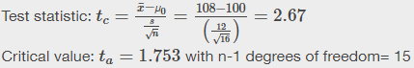
Problem: Jane has just begun her new job as on the sales force of a very competitive company. In a sample of 16 sales calls it was found that she closed the contract for an average value of 108 dollars with a standard deviation of 12 dollars. Test at 5% significance that the population mean is at least 100 dollars against the alternative that it is less than 100 dollars. Company policy requires that new members of the sales force must exceed an average of $100 per contract during the trial employment period. Can we conclude that Jane has met this requirement at the significance level of 95%?
Solution 1
H₀: µ ≤ 100 H_{a}: µ > 100 The null and alternative hypothesis are for the parameter µ because the number of dollars of the contracts is a continuous random variable. Also, this is a one-tailed test because the company has only an interested if the number of dollars per contact is below a particular number not "too high" a number. This can be thought of as making a claim that the requirement is being met and thus the claim is in the alternative hypothesis.

Slide 54
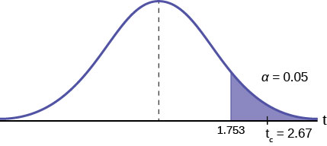
Comparing the calculated value of the test statistic and the critical value of tt (ta)(ta) at a 5% significance level, we see that the calculated value is in the tail of the distribution. Thus, we conclude that 108 dollars per contract is significantly larger than the hypothesized value of 100 and thus we cannot accept the null hypothesis. There is evidence that supports Jane's performance meets company standards.
Comparing the calculated value of the test statistic and the critical value of t (ta) at a 5% significance level, we see that the calculated value is in the tail of the distribution.
Thus, we conclude that 108 dollars per contract is significantly larger than the hypothesized value of 100 and thus we cannot accept the null hypothesis.
There is evidence that supports Jane's performance meets company standards.

Slide 55
Problem
A manufacturer of salad dressings uses machines to dispense liquid ingredients into bottles that
move along a filling line. The machine that dispenses salad dressings is working properly when 8
ounces are dispensed. Suppose that the average amount dispensed in a particular sample of 35
bottles is 7.91 ounces with a variance of 0.03 ounces squared, s2. Is there evidence that the
machine should be stopped and production wait for repairs?
The lost production from a shutdown is potentially so great that management feels that the level
of significance in the analysis should be 99%.
Solution:
this is a two-tailed test: if the machine is malfunctioning it will be shutdown regardless if it is
from over-filling or under-filling. The null and alternative hypotheses are thus:
H0:μ=8
Ha:μ≠8
This is a continuous random variable and we are interested in the mean, and the sample size is greater than 30, the appropriate distribution is the normal distribution and the relevant critical value is 2.575 from the normal table or the t-table at 0.005 column and infinite degrees of freedom.

Slide 56
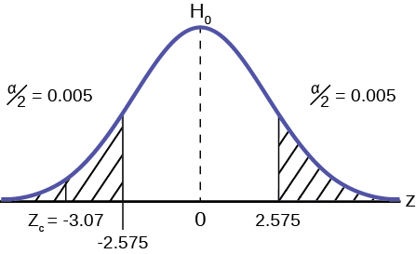
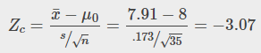
Sample mean : 7.91
Sample variance : .03 and the sample size is 35. The standard deviation is simply the square root of the variance, we therefore know the sample standard deviation, s, is 0.173.
With this information we calculate the test statistic as -3.07, and mark it on the graph.
Compare test statistic and the critical values Now we compare the test statistic and the critical value by placing the test statistic on the graph. We see that the test statistic is in the tail, decidedly greater than the critical value of 2.575. We note that even the very small difference between the hypothesized value and the sample value is still a large number of standard deviations. The sample mean is only 0.08 ounces different from the required level of 8 ounces, but it is 3 plus standard deviations away and thus we cannot accept the null hypothesis.
Our formal conclusion would be “ At a 99% level of significance we cannot accept the hypothesis that the sample mean came from a distribution with a mean of 8 ounces” Or less formally, and getting to the point, “At a 99% level of significance we conclude that the machine is under filling the bottles and is in need of repair”.

Slide 57
Unsolved Questions

Slide 58
1. The mean throwing distance of a football for Marco, a high school freshman quarterback, is 40 yards, with a standard deviation of two yards. The team coach tells Marco to adjust his grip to get more distance. The coach records the distances for 20 throws. For the 20 throws, Marco’s mean distance was 45 yards. The coach thought the different grip helped Marco throw farther than 40 yards. Conduct a hypothesis test using a preset α = 0.05. Assume the throw distances for footballs are normal.
First, determine what type of test this is, set up the hypothesis test, find the p-value, sketch the graph, and state your conclusion.
2. It is believed that a stock price for a particular company will grow at a rate of $5 per week with a standard deviation of $1. An investor believes the stock won’t grow as quickly. The changes in stock price is recorded for ten weeks and are as follows: $4, $3, $2, $3, $1, $7, $2, $1, $1, $2. Perform a hypothesis test using a 5% level of significance. State the null and alternative hypotheses, state your conclusion, and identify the Type I errors.

Slide 59
Reference
https://www.statology.org/tables/
Critical Value Tables
Binomial Distribution Table Chi-square Distribution Table Dunnett’s Table Durbin-Watson Table F Distribution Table Mann-Whitney U Table Pearson Correlation Critical Values Table t-Distribution Table Wilcoxon Signed Rank Test Critical Values Table Z Table
How to Use the Critical Value Tables
How to Find the P-Value from the F-Distribution Table How to Find the P-Value from the t-Distribution Table How to Find the P-Value from the Chi-Square Distribution Table How to Read the Binomial Distribution Table How to Read the F-Distribution Table How to Read the t-Distribution Table How to Read the Chi-Square Distribution Table How to use the Z Table

Slide 60
Reference
https://www.statisticshowto.com/tables/z-table/
https://openstax.org/books/introductory-business-statistics/pages/9-4-full-hypothesis-test-examples

